Slide 1

Web Application Development
COMP-229
Fall 2023

Slide 2
Checking the standalone backend
There are a number of options when it comes to selecting tools to check backend
APIs, ranging from the command-line tool curl (https://github.com/curl/curl)
To Advanced REST Client (ARC)
(https://chrome.google.com/webstore/detail/advanced-rest-client/hgmloofddffdnphfgcellkdfbfbjeloo), a Chrome extension app with an interactive user interface.
POSTMAN
To check the APIs that were implemented in this chapter, first, have the server running from the command line and use either of these tools to request the routes.

Slide 3
Checking the standalone backend Contd.
If you are running the code on your local machine, the root URL is http://localhost:3000/.
Using POSTMAN, we will showcase the expected behavior for five use cases so that we can check the implemented API endpoints.

Slide 4
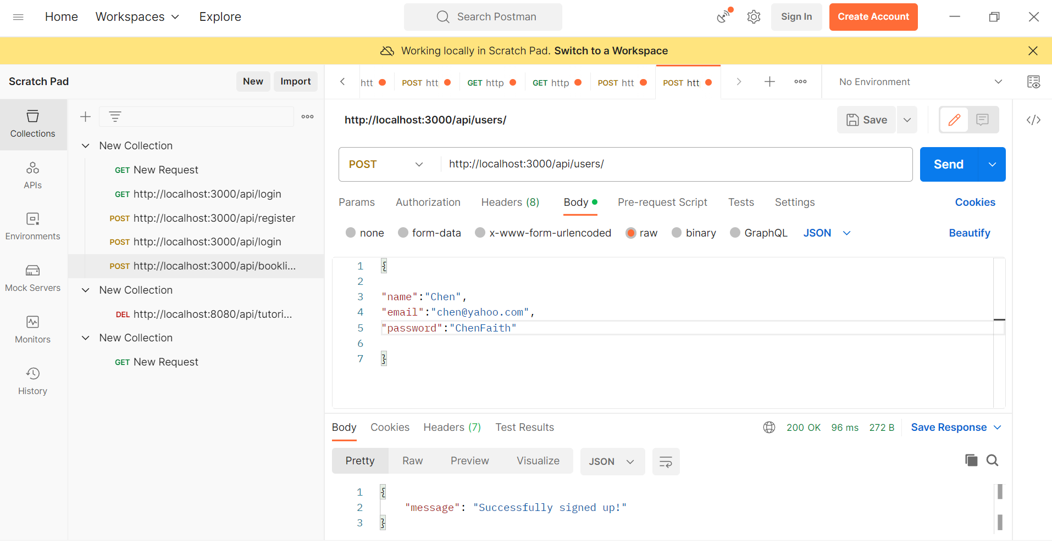
Creating a new user

Slide 5
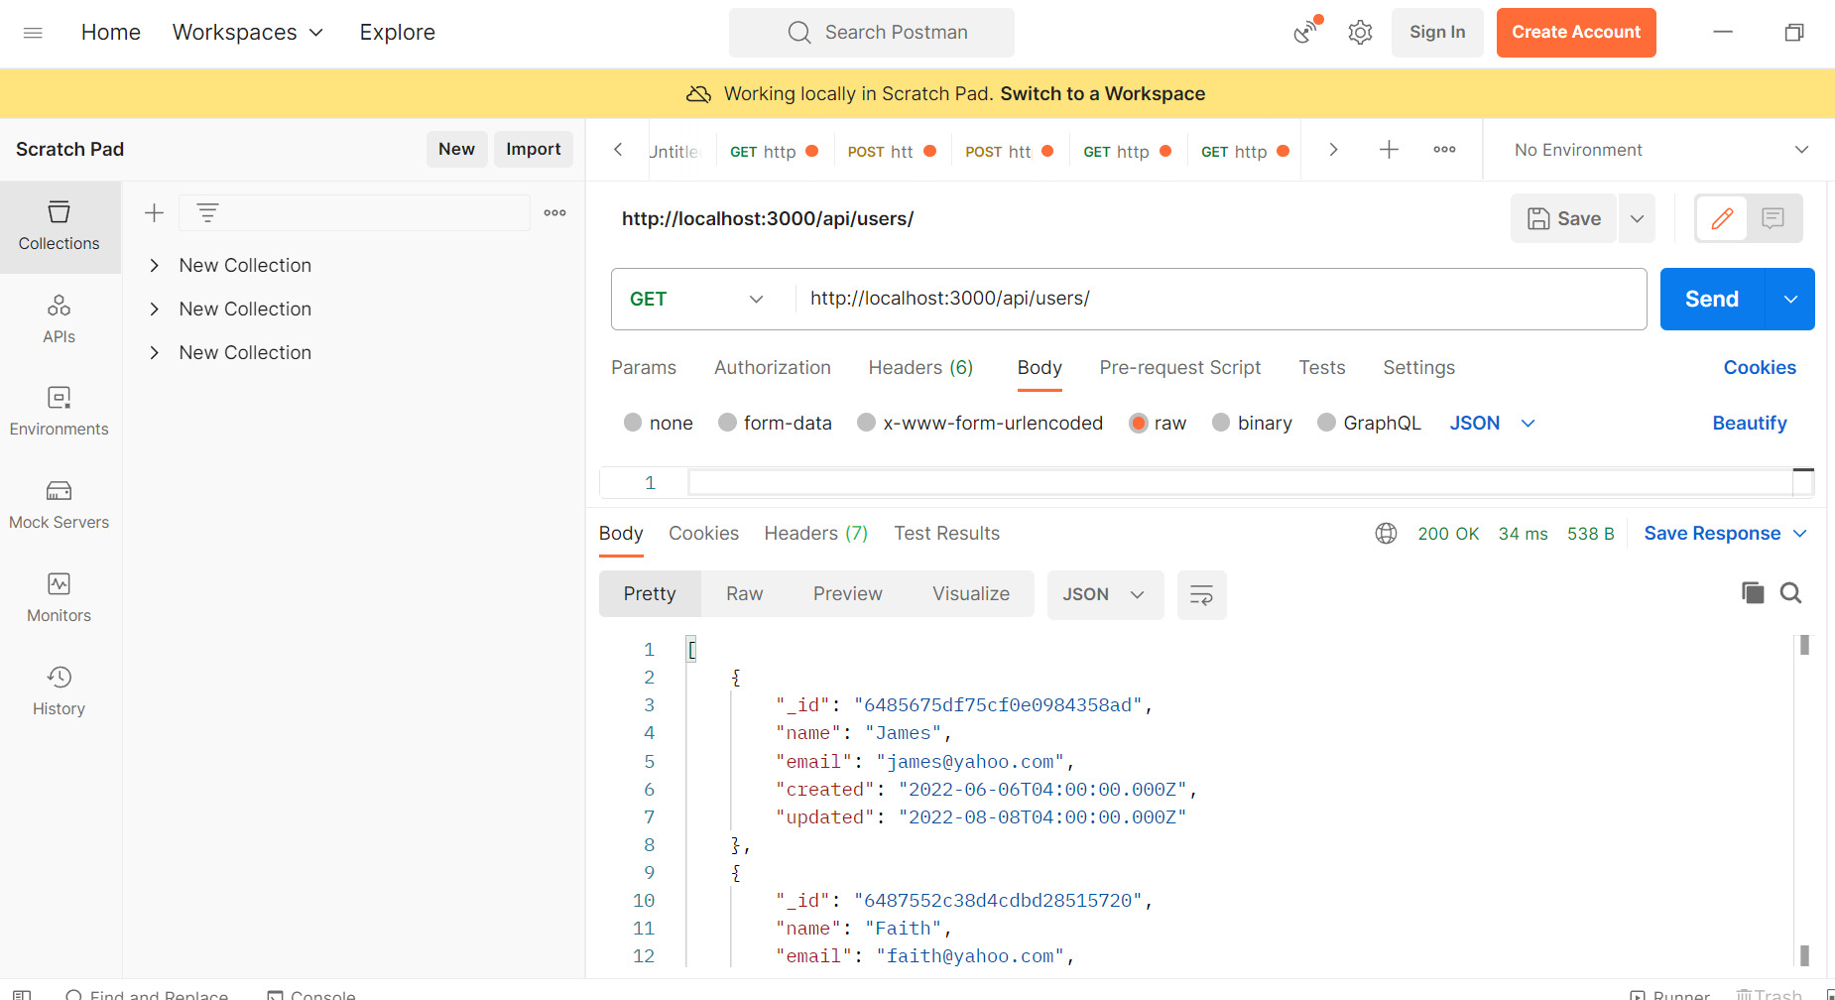
Fetching the user list
We can see whether a new user is in the database by fetching a list of all users with a GET request to /api/users.
The response should contain an array of all the user objects stored in the database:

Slide 6
Fetching the user list Contd.
Notice how the returned user objects only show the _id, name, email,and created field values, and not the salt or hashed_password values, which are also present in the actual documents stored in the database.
The request only retrieves the selected fields we specified in the Mongoose find query that we made in the list controller method.
This omission is also in place when fetching a single user.

Slide 7
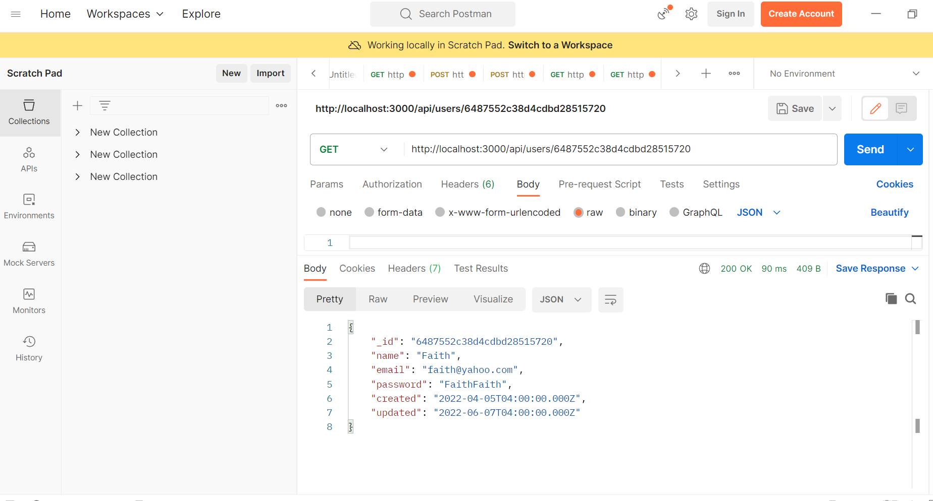
Fetching a single user
Fetching a single user by id:

Slide 8
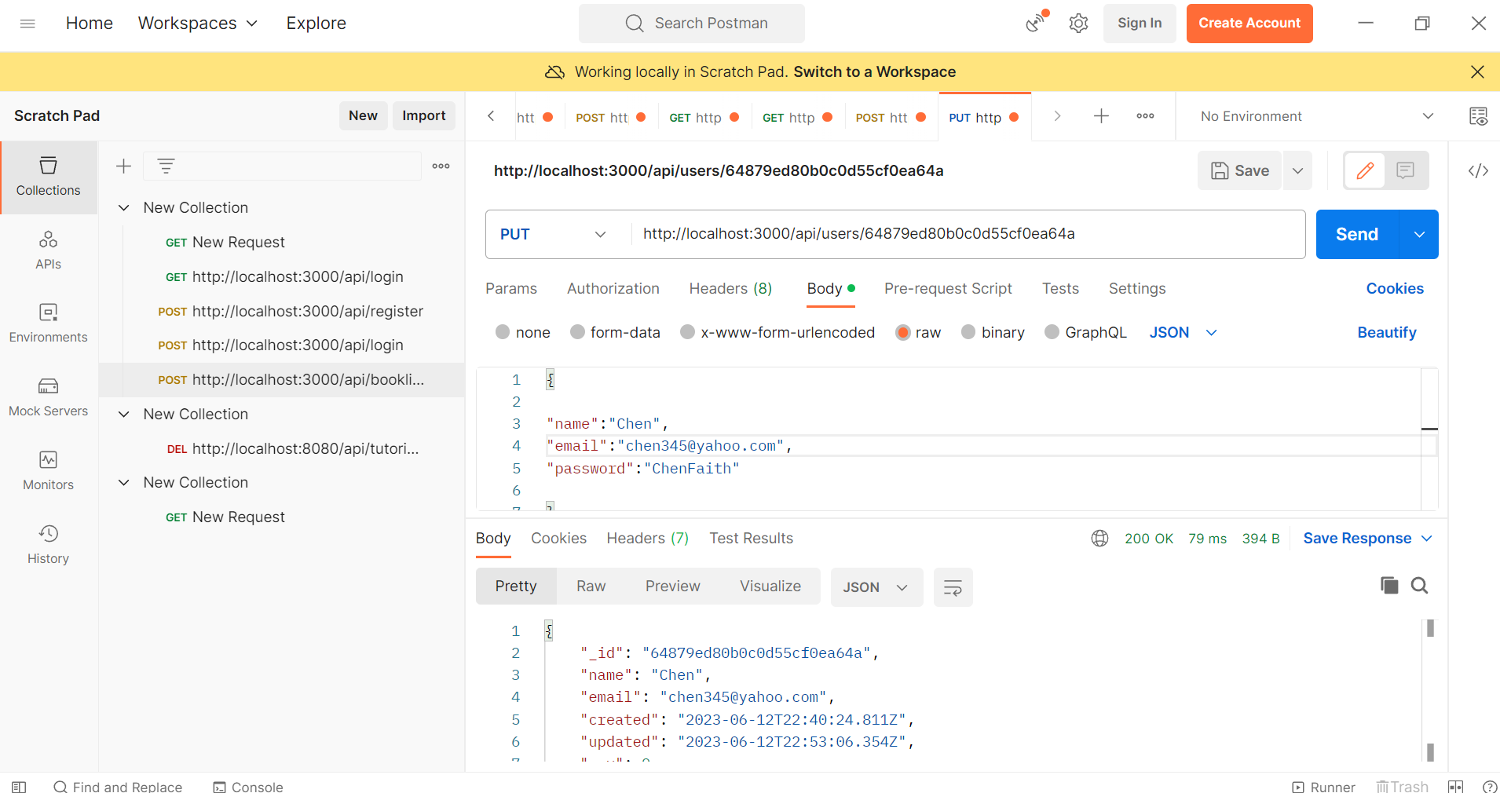
Updating a user
Updating a user using PUT

